Slide 1
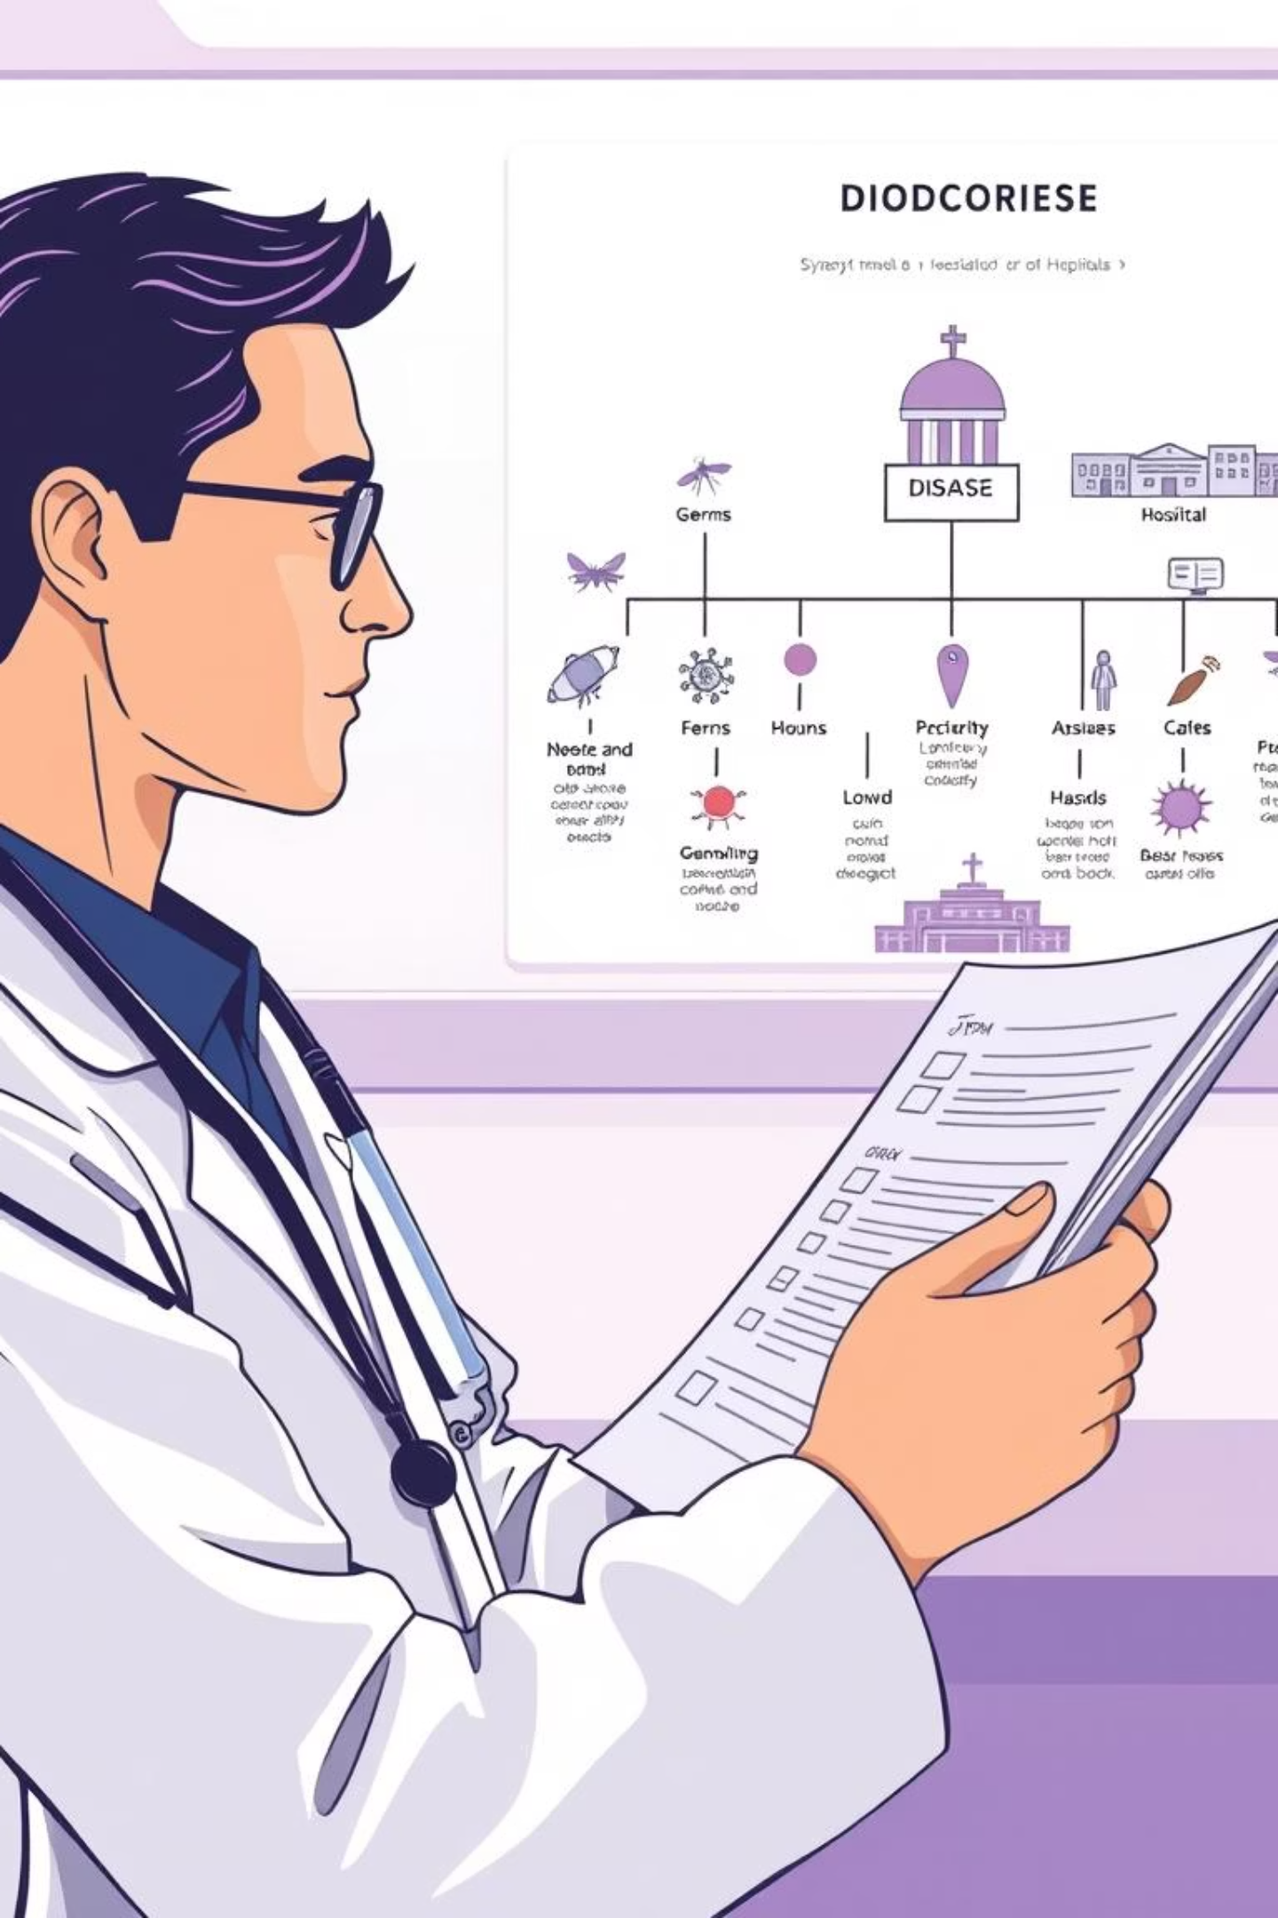
Integrated Science: Diseases Affecting Humans
This presentation explores the fundamentals of human diseases, their classifications, causes, symptoms, and prevention methods. We'll examine both communicable and non-communicable diseases that affect human health and discuss practical approaches to disease prevention and management.

Slide 2
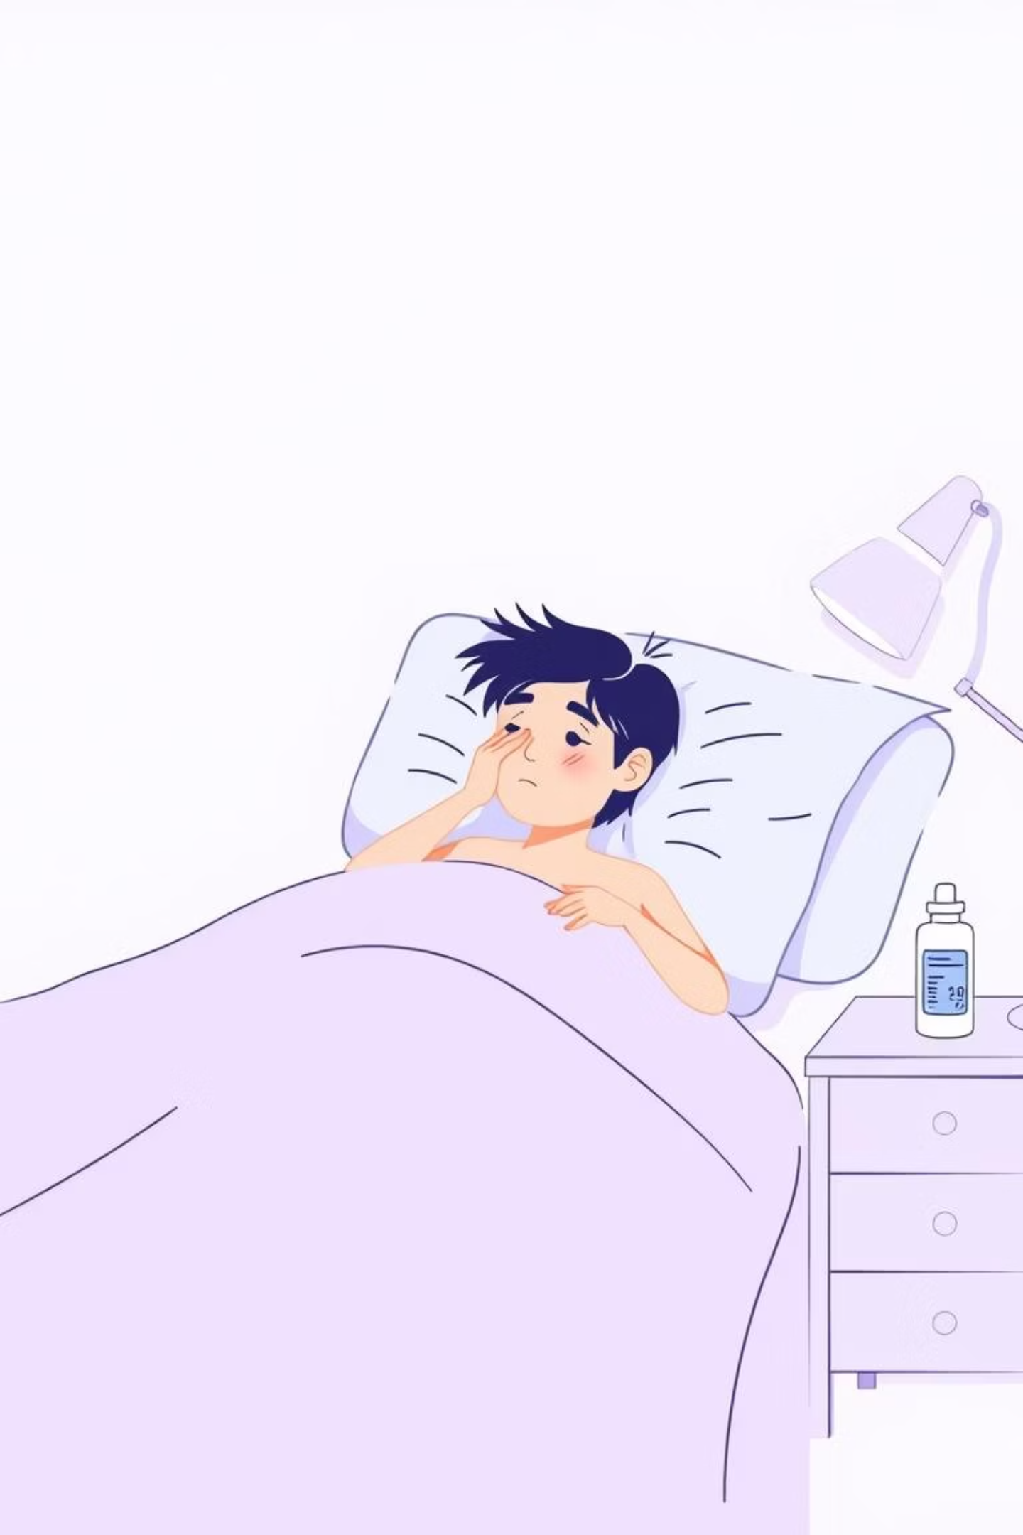
What is a Disease?
Definition
A condition that makes the body or part of it unable to function properly.
Effects
Causes weakness, sickness, and prevents normal activities.
Examples
Malaria, Cholera, Measles

Slide 3
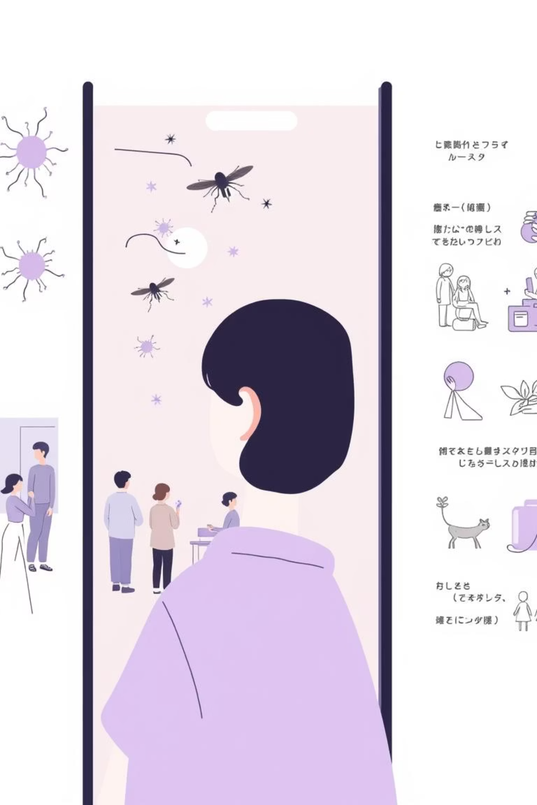
Types of Human Diseases
Communicable Diseases
Non-Communicable Diseases
Spread from one person to another
Do not spread from person to person
Caused by germs (viruses, bacteria, parasites, fungi)
Caused by lifestyle, heredity, or old age
Examples: Malaria, Cholera, TB, HIV/AIDS, Measles
Examples: Diabetes, Hypertension, Asthma

Slide 4
Viral Diseases
Disease
Cause
Spread
Symptoms
Prevention
Measles
Virus
Air (coughing, sneezing)
Rash, fever, cough, red eyes
Immunization, avoid contact
HIV/AIDS
HIV virus
Blood, unprotected sex, mother-to-child
Weight loss, frequent illness, weakness
Safe sex, HIV testing, clean needles
Hepatitis B
Virus
Infected blood/body fluids
Jaundice (yellow eyes/skin), tiredness, stomach pain
Vaccination, avoid sharing sharp objects
Viral diseases are caused by viruses, which are microscopic infectious agents that can only replicate inside the cells of living hosts.

Slide 5
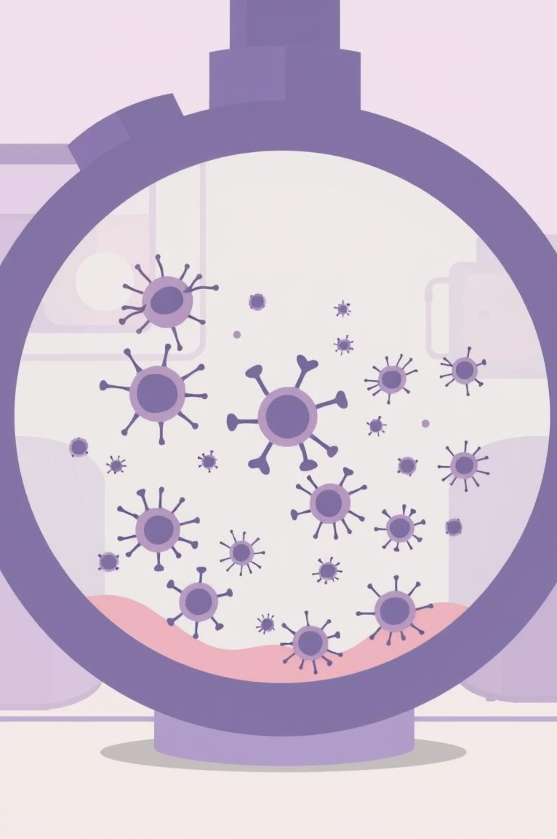
Bacterial Diseases
Cholera
Cause: Vibrio cholerae
1
Spread: Contaminated food/water
Symptoms: Severe diarrhea, vomiting, dehydration
Prevention: Clean water, handwashing, sanitation
Tuberculosis
Cause: Mycobacterium tuberculosis
2
Spread: Air (cough droplets)
Symptoms: Persistent cough, chest pain, weight loss
Prevention: Ventilation, cover mouth, early treatment
Meningitis
Cause: Bacteria
3
Spread: Close contact
Symptoms: Stiff neck, headache, fever
Prevention: Vaccination, avoid overcrowding, treatment

Slide 6
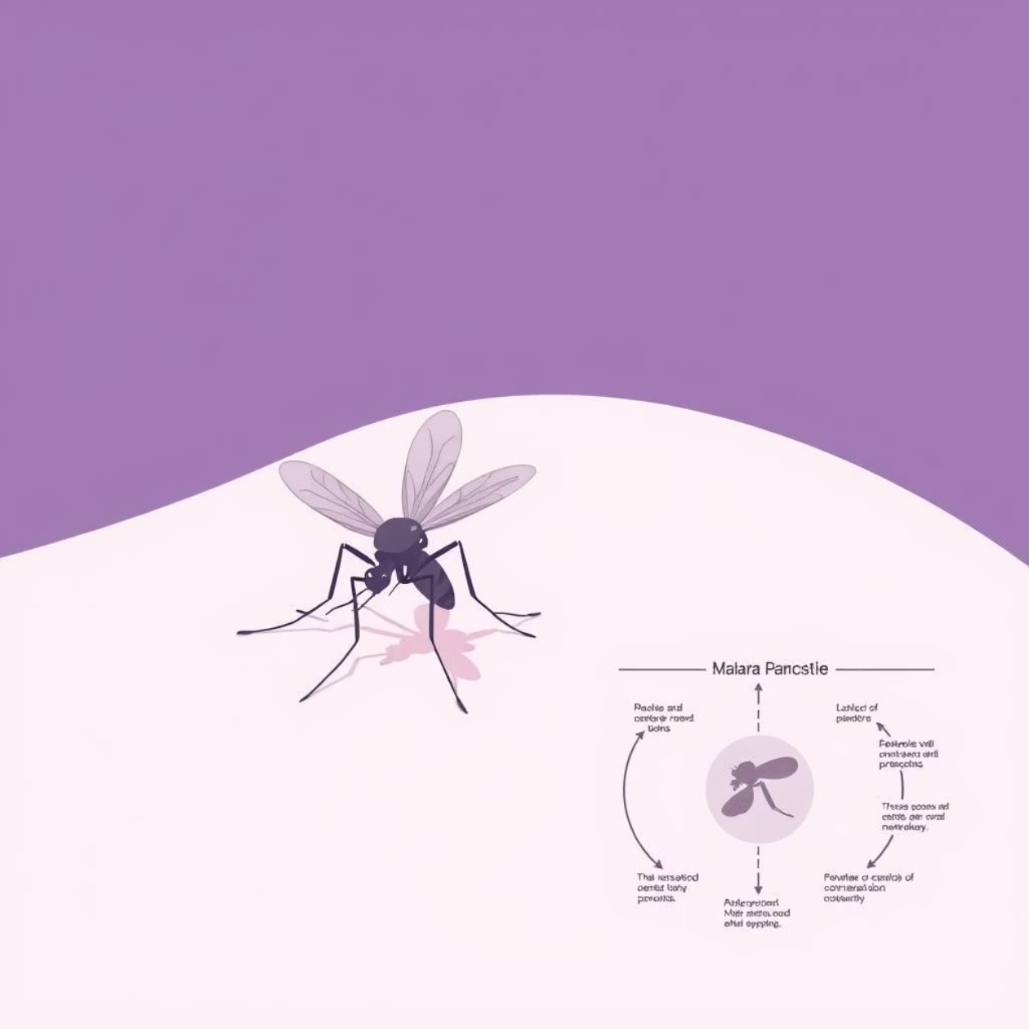
Parasitic Diseases: Malaria
Malaria Facts
Cause: Plasmodium parasite via female Anopheles mosquito
Spread: Mosquito bites
Symptoms: Fever, chills, body pain, sweating
Prevention: Mosquito nets, clear stagnant water, insect repellent sprays
Malaria remains one of the most prevalent parasitic diseases globally, particularly affecting tropical and subtropical regions.

Slide 7



Non-Communicable Diseases
Diabetes
Hypertension
Asthma
Cause: Body cannot control blood sugar
Cause: High blood pressure (stress, excess salt/fat)
Cause: Allergy to dust, smoke, cold air
Symptoms: Frequent urination, thirst, weakness
Symptoms: Headache, dizziness, tiredness
Symptoms: Difficulty breathing, wheezing
Management: Healthy diet, exercise, medical care
Management: Reduce salt, exercise, regular check-ups
Management: Avoid triggers, inhaler, clean environment
Unlike communicable diseases, these conditions cannot be transmitted between people but are often influenced by genetics, environment, and lifestyle choices.

Slide 8
General Prevention of Diseases
01
02
03
Personal Hygiene
Clean Environment
Balanced Diet
Bath regularly, wash hands with soap, brush teeth
Dispose of refuse properly, clear stagnant water
Eat nutritious foods to build strong immunity
04
05
06
Vaccination
Safe Food and Water
Exercise and Rest
Get immunized against measles, polio, tetanus, hepatitis, meningitis
Boil/clean water, eat properly cooked food
Keep body fit with regular physical activity and adequate rest
07
Medical Care
Visit hospital when sick, avoid self-medication

Slide 9
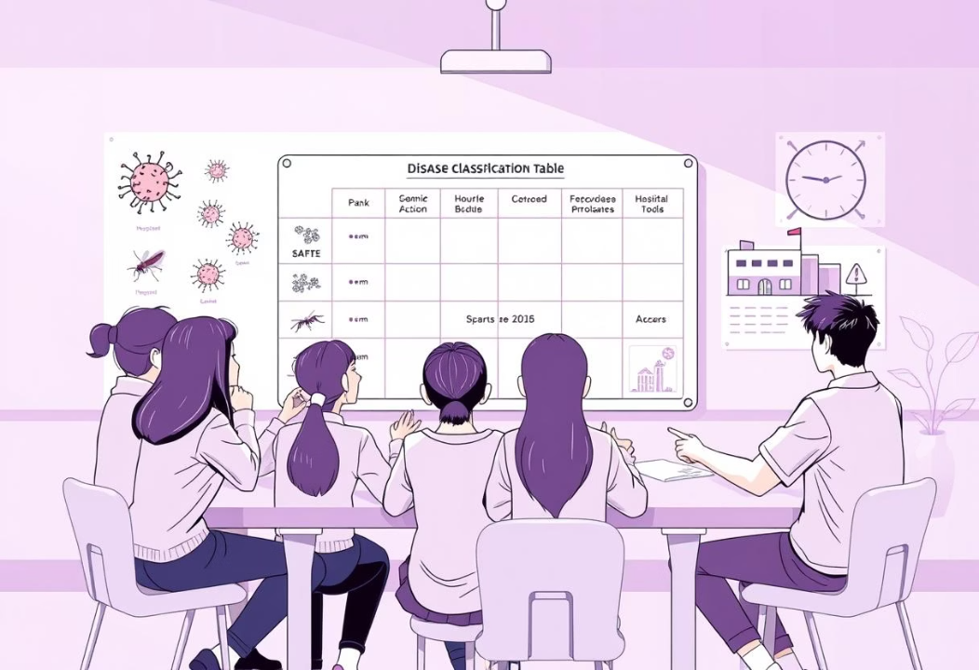
Teaching Activities
Table Creation
Group Classification
Role Play
Students draw tables showing disease cause, symptoms, and prevention methods for different diseases.
Group work: Students list and classify different diseases as communicable or non-communicable.
"Doctor and patient" scenario where students explain symptoms and prevention methods for various diseases.
These interactive activities help students better understand and remember disease concepts through practical application.

Slide 10







Summary
Disease Definition
Communicable
Conditions that make the body unable to function properly
Spread through germs: Malaria, Cholera, TB, Measles, HIV/AIDS
Prevention
Non-Communicable
Hygiene, sanitation, vaccination, healthy living, medical care
Don't spread: Diabetes, Hypertension, Asthma
Understanding diseases and their prevention is crucial for maintaining good health and preventing the spread of infectious conditions in communities.

